Slide 1

Sample, data collection and instruments

Slide 2
Quantitative designs
Surveys
Is the purpose of the survey design clearly specified?
What type of design will be used, and what are the reasons for choosing
Is the nature of the survey identified
Is the population described and is its size indicated?
Will the population be stratified? If so, how will stratification be implemented?
How many individuals will be in the sample, and on what basis was this size chosen?
What will be the procedure for sampling these individuals
What instruments will be used in the survey
Do the instruments have acceptable score reliability and validity, and what are the scale anchors?
What is the timeline for administering the survey?
What ethical considerations will be taken into account to protect participants?
Purpose of the instrument
1
2
Sampling process
3
Instrument development
4
Instrument administration

Slide 3
Quantitative designs
Surveys
1
2
3
Purpose of the Instrument
Sampling Process
Instrument Development

Slide 4

Quantitative designs
Surveys
The purpose
To answer one or more research questions about variables of interest.
Type of Survey Method
Indicate whether the survey will be cross‑sectional, with data collected at one point in time, or longitudinal, with data collected over time.
“The main purpose of this survey study is to empirically assess whether the number of overtime hours worked predicts subsequent symptoms of burnout in a sample of emergency‑room nurses.”
Fowler (2014)
Modes of Data Collection
Fowler (2014) identifies the following types:
The justification
When justifying the choice of method, it is essential to recognise the advantages of survey designs:
Cost‑effectiveness
Rapid data collection
Constraints that prevent the use of other designs
Mail
Telephone
Face‑to‑face interviews
Internet
Group administration
Regarding internet surveys and online administration, there has been significant growth in their popularity because they provide easy access to participants around the world, such as through platforms like Amazon Mechanical Turk and Prolific.
“An experimental design was not adopted to observe the relationship between overtime hours and symptoms of burnout because it would be prohibitively costly and potentially unethical to randomly assign nurses different amounts of overtime.”
Regardless of the data‑collection mode, it is important to justify the chosen procedure, drawing on its strengths, weaknesses, costs, data availability, and convenience.

Slide 5


Quantitative designs
Surveys
Key approaches to obtain factors that would otherwise remain unobservable:
Perceptions
Knowledge
These factors are important because they are determinants of political, social, and economic outcomes.
Attitudes
Beliefs
We are designing and building a process that enables the generation of data.
This allows us to control and identify the level of variation in the information we produce.
Survey design is an integral part of the research process.
❗Surveys should be understood only as one method of data collection.
Stefanie Stantcheva
Social economy Lab at Harvard

Slide 6
25/03/2026
Quantitative designs
Surveys
A clear definition of the research question
A good survey must be adapted to the subject of the research.
When writing survey questions, we must always think about how we are going to analyse them
This means that the design of the survey will always depend on the objectives established for the research
When designing questions, one must:
Keep in mind the concept of ceteris paribus, or “all else held constant”.
Consider the exercise as a way of creating controlled variation.
Ensure that each question addresses only one aspect at a time, keeping everything else as constant as possible (and respondents should be made aware of this).
In social, economic, and political research settings, the objective is not to document or collect statistics (as is the case with administrative records or household surveys).

Slide 7
Quantitative designs
Surveys
1
2
3
Purpose of the Instrument
Sampling Process
Instrument Development

Slide 8
25/03/2026
Quantitative designs
Surveys
Sampling
These rely on quota‑based online panels, such as Qualtrics, Dynata, Bilendi and Prolific Academic.
Like commercial survey companies, but requiring more hands‑on management by the researcher. E.g., Cint.
What type of sample is needed to answer the research question?
Commercial survey companies
Commercial survey marketplaces
Large-scale national probability panels
Populations that are easily accessible to the researcher, such as university students or conference participants.
🗝️
Sampling Range
Nationally representative panels
Convenience samples
The sample must be intentionally diverse in terms of variables that are conceptually relevant to the research question.
Types of Samples and Sampling Sources
Governmental or institutional surveys
Online labour platforms
Such as Mechanical Turk de Amazon (MTurk), positioned between convenience samples and quota‑based panels due to the large number of available respondents..
Typically conducted by national statistical offices.
Targeted or expert samples
For example, experts, employees in a specific firm, economists, or other specialised groups.
Notes:
Paneles representativos a nivel nacional
Empresas comerciales de encuestas. Utilizan paneles con muestreo por cuotas, como Qualtrics, Dynata, Bilendi y Prolific Academic.
Mercados comerciales de encuestas. Similares a las empresas comerciales de encuestas, pero requieren una gestión más interna y práctica del proceso por parte del investigador.
Muestras de conveniencia. Son poblaciones de muestra accesibles de manera conveniente para el investigador. Ejemplos incluyen estudiantes universitarios o participantes en conferencias.
Plataformas de trabajo. Como Mechanical Turk de Amazon (MTurk), que se sitúan entre las muestras de conveniencia y los paneles con muestreo por cuotas, dado el amplio número de participantes disponibles.
Grupos focalizados de fuentes específicas. Como expertos, empleados de una empresa, economistas, etc.
Encuestas gubernamentales o institucionales. Por ejemplo, las realizadas por las oficinas nacionales de estadística

Slide 9
25/03/2026
Quantitative designs
The systematic difference between the target population and the effective sample, arising from non‑random mechanisms at any stage (coverage, recruitment, or response), such that your estimates would be different even with infinite sample size
Selection Bias
Target Population
Sampling Frame / Pool of Possible Respondents
Planned Sample
Effective Sample
Coverage Error
Sampling Error
Non‑response Error
This refers to the population of interest for the research.
For example, all residents of Cali aged between 18 and 25.
This represents all individuals who could potentially be surveyed.
Individuals aged 18–25 who use digital media (≈120,000).
All individuals expected to complete the survey.
Individuals are drawn from the effective frame according to different methods.
3,000 invited; expected 1,000 completes.
All individuals who complete the survey
912 complete and pass quality checks.
The sampling frame includes only residents aged 18–25 who use digital media. However, approximately 25% of youth in low‑income areas of Cali have limited or no access to digital platforms.
Suppose the true proportion of 18–25-year-olds in Cali who support the new public transport policy is 62%. If we were to draw a simple random sample of 1,000 individuals from the sampling frame, the sample estimate might be 59% or 65% purely by chance. This deviation is sampling error
Out of 3,000 invited individuals, only 912 completed the survey. Non‑respondents were mainly full‑time workers with different digital habits. If their views differ from respondents’, estimates may suffer from non‑response error.
Taken from: Surveys can also be done for firms, instead of individuals or households, as done by Link et al. (2022) and Weber et al. (2022)
Notes:
Paneles representativos a nivel nacional
Empresas comerciales de encuestas. Utilizan paneles con muestreo por cuotas, como Qualtrics, Dynata, Bilendi y Prolific Academic.
Mercados comerciales de encuestas. Similares a las empresas comerciales de encuestas, pero requieren una gestión más interna y práctica del proceso por parte del investigador.
Muestras de conveniencia. Son poblaciones de muestra accesibles de manera conveniente para el investigador. Ejemplos incluyen estudiantes universitarios o participantes en conferencias.
Plataformas de trabajo. Como Mechanical Turk de Amazon (MTurk), que se sitúan entre las muestras de conveniencia y los paneles con muestreo por cuotas, dado el amplio número de participantes disponibles.
Grupos focalizados de fuentes específicas. Como expertos, empleados de una empresa, economistas, etc.
Encuestas gubernamentales o institucionales. Por ejemplo, las realizadas por las oficinas nacionales de estadística

Slide 10
25/03/2026
Quantitative designs
Surveys
Sampling
What risks exist regarding representativeness?
1.
Unit Non‑response Bias
🙅🏻‍♂️
The difference between the individuals who actually started the survey and those who were initially expected to do so (selection‑related response error).
2.
Item Non‑response Bias
📔
Occurs when respondents begin the survey (i.e., are part of the effective sample) but do not answer all questions.
Attrition
Refers to the phenomenon whereby respondents exit the survey before completing it. This implies that items after a certain point are not fully answered.
If this “drop‑off” is systematic rather than random, attrition may introduce bias into the instrument.
Notes:
Paneles representativos a nivel nacional
Empresas comerciales de encuestas. Utilizan paneles con muestreo por cuotas, como Qualtrics, Dynata, Bilendi y Prolific Academic.
Mercados comerciales de encuestas. Similares a las empresas comerciales de encuestas, pero requieren una gestión más interna y práctica del proceso por parte del investigador.
Muestras de conveniencia. Son poblaciones de muestra accesibles de manera conveniente para el investigador. Ejemplos incluyen estudiantes universitarios o participantes en conferencias.
Plataformas de trabajo. Como Mechanical Turk de Amazon (MTurk), que se sitúan entre las muestras de conveniencia y los paneles con muestreo por cuotas, dado el amplio número de participantes disponibles.
Grupos focalizados de fuentes específicas. Como expertos, empleados de una empresa, economistas, etc.
Encuestas gubernamentales o institucionales. Por ejemplo, las realizadas por las oficinas nacionales de estadística

Slide 11
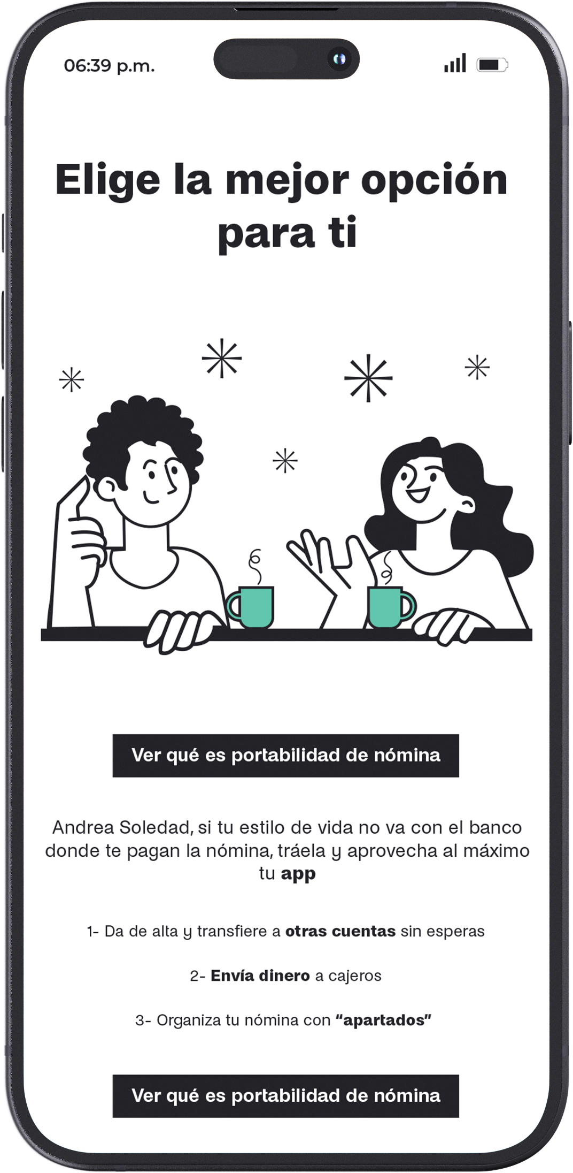
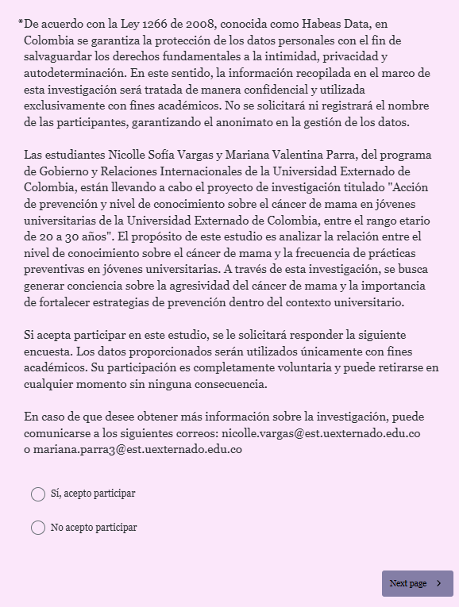
25/03/2026
Quantitative designs
Surveys
Recruitment
The First Page of the Survey 📎
Reduce the perceived costs of participating in the survey from the outset by specifying the expected duration.
Use simple language and a visually friendly design.
Do not disclose too much information about the identity of the survey administrator.
Provide contact information so that respondents may submit complaints, questions, or comments.
Offer details on how the data will be stored and used.
Reaffirm the commitment to anonymity and confidentiality.
Present limited information regarding the purpose/objective of the study.
Explain the potential benefits derived from participation.
Warn respondents about the importance of providing high‑quality responses.
Notes:
Paneles representativos a nivel nacional
Empresas comerciales de encuestas. Utilizan paneles con muestreo por cuotas, como Qualtrics, Dynata, Bilendi y Prolific Academic.
Mercados comerciales de encuestas. Similares a las empresas comerciales de encuestas, pero requieren una gestión más interna y práctica del proceso por parte del investigador.
Muestras de conveniencia. Son poblaciones de muestra accesibles de manera conveniente para el investigador. Ejemplos incluyen estudiantes universitarios o participantes en conferencias.
Plataformas de trabajo. Como Mechanical Turk de Amazon (MTurk), que se sitúan entre las muestras de conveniencia y los paneles con muestreo por cuotas, dado el amplio número de participantes disponibles.
Grupos focalizados de fuentes específicas. Como expertos, empleados de una empresa, economistas, etc.
Encuestas gubernamentales o institucionales. Por ejemplo, las realizadas por las oficinas nacionales de estadística

Slide 12
Quantitative designs
Surveys
Provides a quantitative description of trends, attitudes, and opinions, and tests associations between variables of a population by studying a sample.
1
2
3
Descriptive questions
Questions about relationships between variables
Longitudinal structures
What percentage of the company’s employees support the hiring of foreign workers?
Is there an association between the number of foreign employees and overall job‑satisfaction perceptions among employees?
Does the hiring of new foreign employees at Time 1 predict higher job satisfaction at Time 2?
Population
S1
S3
S2
S4
S5

Slide 13
Quantitative designs
Population
A population is the set of all elements of interest in a study.
Sample
The primary purpose of statistical inference
A sample is a subset of the population.
The principal goal of statistical inference is to make estimates and conduct hypothesis tests about population parameters using the information provided by a sample.
Parameter
A parameter is a fixed characteristic of the population.
It is often difficult, and in many cases costly, to obtain population‑level data. Consider the implementation of censuses to gather sociodemographic information.
Indicators
A useful alternative to obtaining population data is to study samples (specifically, their statistics) to infer the characteristics of the population to which the sample belongs.
Indicators (or sample statistics) are quantities computed from the sample.

Slide 14
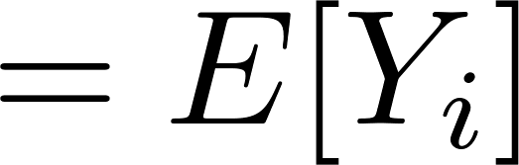
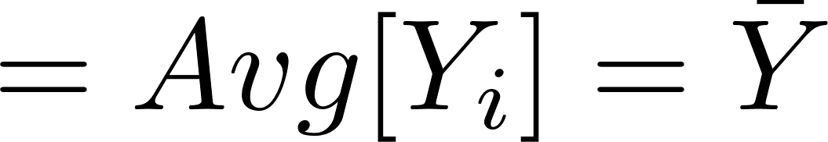
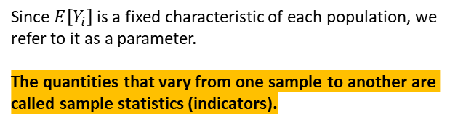
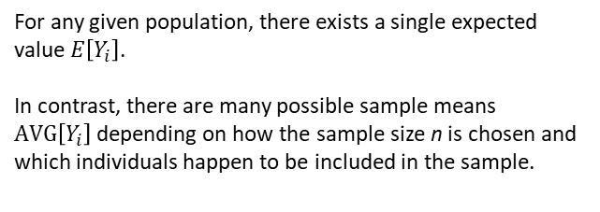
Quantitative designs
Uncertainty Generated by Random Sampling
Objective
To reproduce the same mean for the entire population, that is, if we want to study the mean, we aim to estimate the average evaluated across all individuals in the population of interest.
1.
Expected Value and samples
2.
Population parameters
For any given population, there exists a single expected value $E\left[Y_{i}\right]$.
In contrast, there are many possible sample means $AVG\left[Y_{i}\right]$depending on how the sample size n is chosen and which individuals happen to be included in the sample.
Since $E\left[Y_{i}\right]$is a fixed characteristic of each population, we refer to it as a parameter.
The quantities that vary from one sample to another are called sample statistics (indicators).
Expected Value
Sample Mean

Slide 15
Quantitative designs
Measure | Sample | Population
Mean
Standard deviation
Variance
Observations
Variation coefficient
indicators
parameters

Slide 16




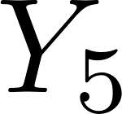

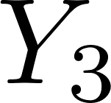
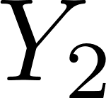
Quantitative designs
How can we determine whether statistical results constitute solid evidence, or whether they are little more than outcomes unlikely to be replicated in another sample?
What level of variability should we expect across samples?

Slide 17
Quantitative designs

Slide 18
Quantitative designs
The law of large numbers tells us that, for large samples, the sample mean is very likely to be very similar to the population mean.
In other words, if we were to draw infinitely many random samples and compute the sample mean Avg[Y] for each of them, the average of all these sample means would converge to the true population mean, E[Y].
A related property states that the expected value of the sample mean, Avg[Y], is equal to the population expected value, E[Y].

Slide 19
25/03/2026
Quantitative designs
Uncertainty Generated by Random Sampling
What statistical tests should be used?
A statistical test is a rule defined a priori (i.e., before accessing the data) that specifies what must be observed in the data to justify rejecting the null hypothesis (H₀).
A result meeting this criterion is labelled “statistically significant.”
Technically, the significance level may be set at any value, provided it is chosen before examining the data.
What is required for a statistical test?
A pre‑specified significance level establishes a “reasonable level of doubt.” Alpha is the upper bound on the probability of rejecting H₀ when H₀ is true (Type I error).
For a one‑sided test (e.g., H₀: A ≥ B), it is the maximum probability of rejecting H₀ in any situation where A ≤ B.
For a two‑sided test (H₀: A = B), it is the probability of rejecting H₀ when A = B.
It is not acceptable to set α = 5% a priori and then, after seeing the results, change it to 7% post hoc just to reach significance.
❗You cannot change the rules of the game once you have seen the outcome.

Slide 20
Quantitative designs
 | H0 True | H0 False
Reject H0 | Type I error | Correct decision
Do not reject H0 | Correct decision | Type II error
The general procedure for hypothesis testing consists of setting the significance level α at a small value (often 0.05) so that the probability of committing a Type I error is limited.
Given a fixed value of α, we select a statistical test, defined by its rejection region, that makes β (the probability of a Type II error) as small as possible.
In other words, we aim to find the most powerful test for the specified significance level.
🧪
By doing so, we prioritise H₀ over H₁, acknowledging that a Type I error is typically considered more serious than a Type II error.

Slide 21
Quantitative designs
Population under H0 (we care about the parameters)
🧪 Null hypothesis (H0)
Within the population, a medication administered to reduce blood pressure has no effect.
H0: (Y | 💊 ) = (Y | 🚫💊)
Under the null hypothesis, the average blood pressure level of individuals who took the medication (💊) and those who did not take the medication (🚫💊) is the same.
🚫💊 Mean value of the blood pressure in those who were not exposed to de medication in the population under H0
💊 Mean value of blood pressure in those who were not exposed to de medication in the population under H0
🚫💊
💊

Slide 22
Quantitative designs
Population under H0 (we care about the parameters)
Observed sample (we care about the indicators)
💊Observed average blood pressure in those who were exposed to de medication in the sample
🚫💊
💊
🚫💊
💊
🚫💊Observed average blood pressure in those who were not exposed to de medication in the sample

Slide 23
Quantitative designs
Observed sample (we care about the indicators)
How probable is it to obtain a sample in which the estimated effect appears as least as large as observed, if the medication has no effect in the population?
If this probability is low:
Then we must ask whether, in the population, the medication might indeed have an effect.
In such cases, the observed sample result may provide sufficient evidence to reject H₀, because what we observe in the sample is inconsistent with what is established under the null hypothesis (H₀).
🚫💊
💊
Notes:
Asumiendo que en la población la diferencia es nula ($H_0$ es cierta), ¿qué tan probable es obtener por puro azar una diferencia igual o más extrema que la que observé en mi muestra?
Si esa probabilidad es muy pequeña (menor a mi nivel de significancia $\alpha$), entonces la evidencia de mi muestra es estadísticamente incompatible con la hipótesis de que no hay efecto. Esto no elimina el azar, pero lo vuelve una explicación tan poco probable que me da una base racional para dudar de la hipótesis nula y, por lo tanto, rechazarla en favor de la existencia de un efecto real."

Slide 24
Quantitative designs
Observed sample (we care about the indicators)
How far is the observed sample result from what the null hypothesis (H₀) predicts?
P-Value:
The p‑value answers this question.
It is the probability of obtaining a sample whose indicators deviate as much as, or more than, those observed, assuming that H₀ is true.
If this probability is low, the sample result is inconsistent with H₀, providing grounds to reject the null hypothesis.
🚫💊
💊

Slide 25
Quantitative designs
Observed sample (we care about the indicators)
P-Value:
If the p‑value is 0.01
You are NOT saying “there is a 99% probability that the treatment works.”
What you are saying is: “If the treatment did not work, I would see data like this in only 1 out of every 100 experiments. Since that would be very rare, I am more inclined to believe that the treatment does have an effect.”
🚫💊
💊

Slide 26
Quantitative designs
 | H0 True | H0 False
Reject H0 | Type I error | Correct decision
Do not reject H0 | Correct decision | Type II error
🧪 Null Hypothesis (H₀)
Within the population, a medication administered to reduce blood pressure has no effect.
Type I error
Rejecting H₀ when it is in fact true.
Type II error
Failing to reject H₀ when it is in fact false.
🚫💊
💊
🚫💊
💊
🚫💊
💊
🚫💊
💊

Slide 27
25/03/2026
Quantitative designs
Surveys
The number of people in the sample and the procedures used to calculate this number.
Determining sample size is essentially a trade‑off:
a larger sample yields greater precision
but recruiting more participants consumes time and financial resources.
The population must be stratified before selecting the sample.
Stratification means that specific characteristics of individuals are represented in the sample in the same proportion as in the population.
When individuals are selected at random from a population, these characteristics may or may not appear in the sample in the same proportions as in the population, and stratification ensures their representation.
Sampling
Determination of Sample Size
Stratification of the Population
Single‑stage sampling
The researcher has direct access to individuals in the population and can sample people (or other elements) directly.
Multi‑stage or cluster sampling
First, clusters (groups or organisations) are identified; then the individuals within those clusters are obtained, and samples are selected within them.
Random sampling Each individual in the population has an equal probability of being selected (systematic or probability‑based sampling)
Systematic sampling
A random starting point is chosen in a list, and every X‑th person is selected.
Convenience sampling
Respondents are selected based on
their convenience and availability.
Sampling Design
Types of Sampling

Slide 28
25/03/2026
Quantitative designs
Determination of Sample Size
In which scenario is your research situated?
Sample sizes determined by convenience, due to operational, economic, or ethical constraints.
The survey design (or experimental design) must adapt to these limiting factors, to the operational aspects of selecting the sample, and to the identification of the population.
More complex survey or experimental designs require larger sample sizes.
Sample-to-item ratio
Relationship between sample size and number of items
1.
If your questionnaire contains 50 items, a 10:1 ratio suggests a sample of 500 participants.
2.
Sample-to-variable ratio
Relationship between sample size and number of variables
If your study includes 5 independent variables, a 20:1 ratio indicates a sample of 100 participants.
3.
Krejcie and Morgan table
A table that provides the recommended sample size for different population sizes
For a population of 1,000, the table suggests a sample size of 278 participants.
4.
Roscoe, Green y Kline guides
Expert recommendations for determining adequate sample sizes in research.
Roscoe suggests a minimum of 30 participants per group in experimental studies.

Slide 29
25/03/2026
Quantitative designs
Determination of Sample Size: Power
Sample‑size calculations (based on power) depend on the specific hypothesis test that will be used in the research:
Example 👀
1
Significance level
2
Test power
Between‑subjects design
Null hypothesis of no treatment effect
Analysis via linear regression or a t‑test
3
Effect size
Continuous outcome variable.

Slide 30
Quantitative designs
Determination of Sample Size: Power
1
Significance level
α is the probability of committing a Type I error, that is, rejecting the null hypothesis (H₀) when it is true.
This corresponds to a false positive: concluding that there is a treatment effect (or a correlation) when there is none.
Therefore, it is essential to choose an appropriate significance level for your tests to minimise the probability of such errors.
It is commonly set at 5%, although other levels may be used.
2
Test power
3
Effect size

Slide 31
Quantitative designs
Determination of Sample Size: Power
2
Test power
Power of the test (1 − β)
Power is the probability of correctly rejecting the null hypothesis when the true effect is not zero (e.g., ATE ≠ 0 or the correlation is non‑zero).
A conventional benchmark is 80% power: β is the Type II error, failing to reject H₀ when it is false (a false negative).
An experimental design is said to have 80% statistical power if 80% of all possible random assignments would produce observable results (i.e., allow detection of the effect) when the effect actually exists.
1
Significance level
3
Effect size

Slide 32

Quantitative designs
Determination of Sample Size: Power
3
Effect size
Effect Size (relationship) and Minimum Detectable Effect (MDE)
(SES or d) The effect size is the magnitude of the relationship or difference that the study aims to detect. Planning requires specifying a minimum detectable effect (MDE).
To compute it, one must first identify the minimum detectable effect (MDE).
MDE: the minimum difference in outcomes between the treatment group (T) and the control group (C) that the study is designed to detect.
1
Significance level
2
Test power
In practice, the sizes of MDE, SD and SES are often taken from:
Published studies with similar interventions or objectives
Pilots.
Rules of thumb :
If SES = 0.2, the effect size is small.
If SES = 0.5, the effect size is medium.
If SES = 0.8, the effect size is large.
(Cohen, 1969)

Slide 33
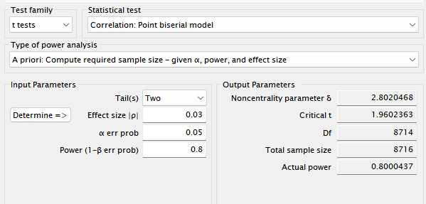

Quantitative designs
Determination of Sample Size: Power
If your analysis plan includes detecting a significant association between variables of interest, a power analysis can help estimate a target sample size.
The input values for a formal power analysis will depend on the questions you wish to address in your design.
This power analysis for determining sample size must be conducted during the planning phase of the study and before enrolling any participants.
Hypothesis: there exists an association between hours of class and subjective well‑being.
Estimated correlation (r): can be obtained from prior, similar studies.
Alpha (α) — significance: Type I error rate, commonly set at 0.05 (a 5% risk of a false positive).
Beta (β): Type II error rate, commonly set at 0.20 (80% statistical power — risk of a false negative).

Slide 34
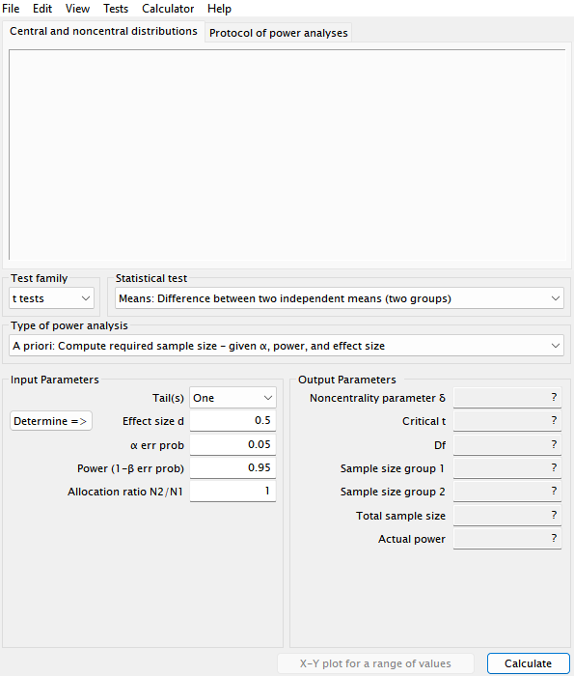
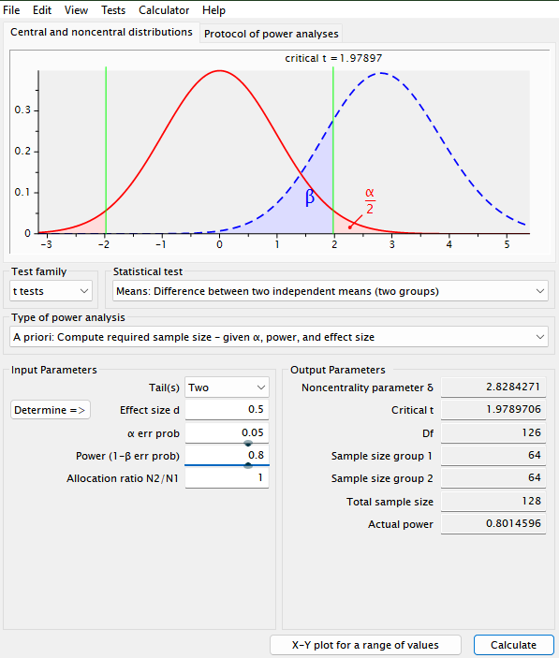
25/03/2026
Quantitative designs
Determination of Sample Size: Power
Define the test type
Define the parameters for the power calculation
1.
2.
Menu : Tests
Tests: Means
Medias: Two independent groups
Effect size: Medium ~ SES = 0.5
Tests: Two tails ~ given the structure of the Null H0: μ1 = μ0
Power: (1- β) = 0.8
Significance: α = 0.5

Slide 35
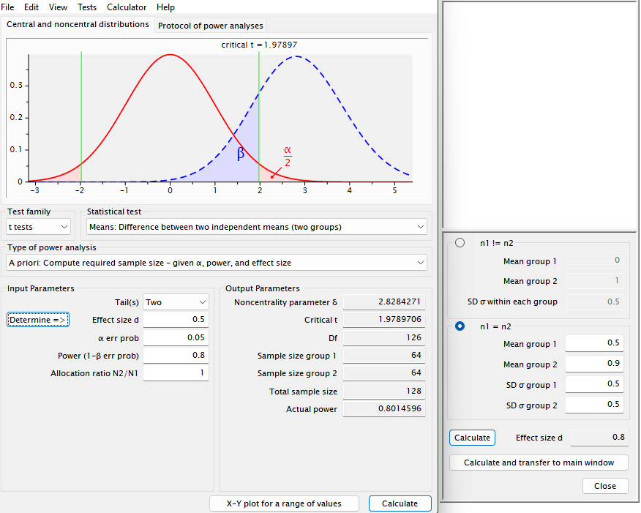
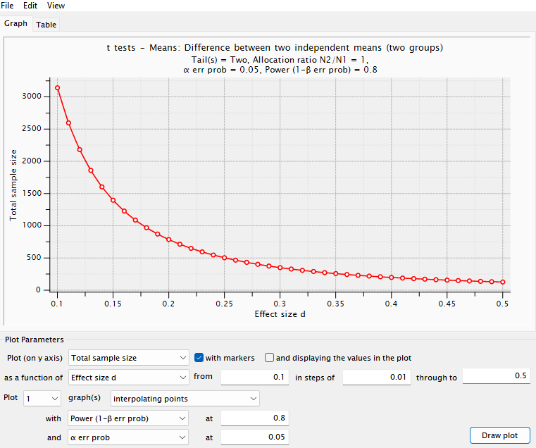
25/03/2026
Quantitative designs
Determination of Sample Size: Power
Simulate the effect size
Simulate sample size scenarios
3.
4.
Input parameter : Determine
Medias: by group
Deviations: by group
Individuals per group: by case
X Y plot for a range of values:
Power: (1- β)
Significance: α
Effect size: SES/d

Slide 36
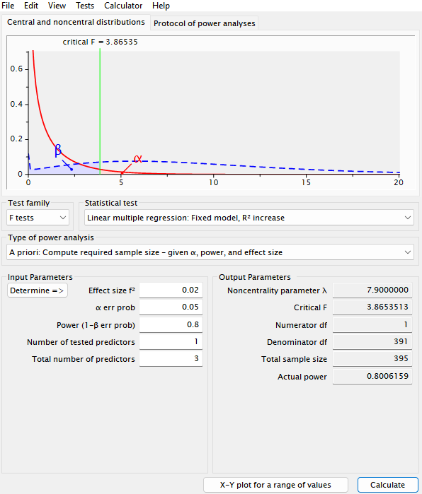
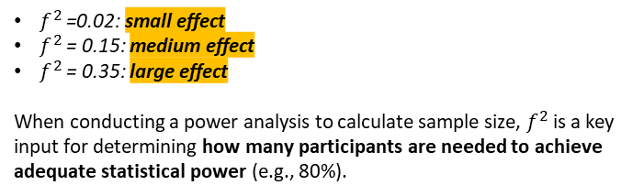
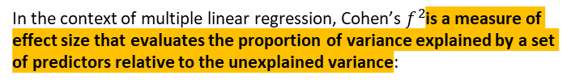
25/03/2026
Quantitative designs
Determination of Sample Size: Power
Define the test type
Define the parameters for the power calculation
1.
2.
Menu : Tests
Tests: F tests
Multiple linear regression: Fixed model, R² increase
Number of predictors: 3
Number of tested predictors:1
Power: (1- β) = 0.8
Significance: α = 0.5
In the context of multiple linear regression, Cohen’s $f^{2}$is a measure of effect size that evaluates the proportion of variance explained by a set of predictors relative to the unexplained variance:
$f^{2}$=0.02: small effect
$f^{2}$ = 0.15: medium effect
$f^{2}$= 0.35: large effect
When conducting a power analysis to calculate sample size, $f^{2}$is a key input for determining how many participants are needed to achieve adequate statistical power (e.g., 80%).

Slide 37
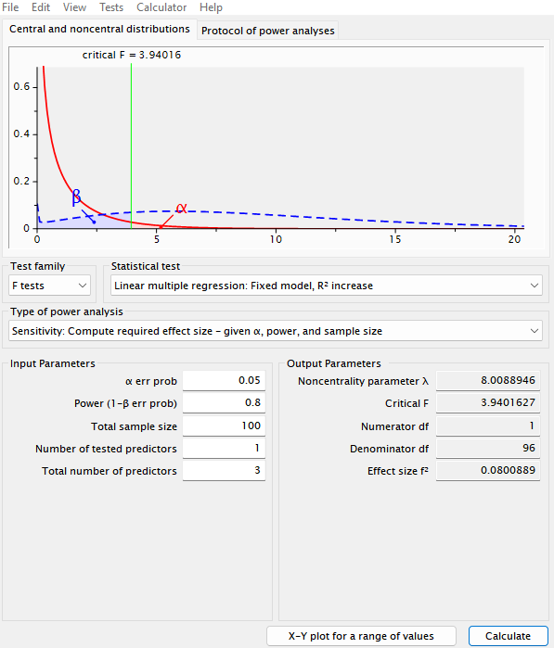
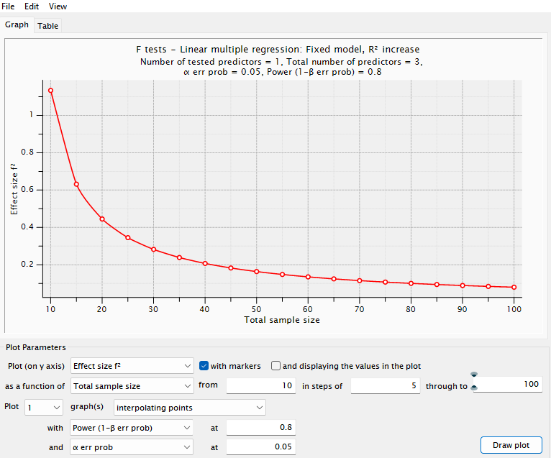
25/03/2026
Quantitative designs
Determination of Sample Size: Power
What happens if the number of participants is limited by the available resources?
Define the parameters for the power calculation
Sometimes, limited resources (e.g., time, budget, or participant availability) determine the maximum number of participants you can include in your study.
Number of predictors: 3
Number of tested predictors:1
Sample :100
Power: (1- β) = 0.8
Significance: α = 0.5
Sensitivity and power analysis is used to compute the minimum effect size that can be reliably detected with the available sample size, while maintaining, for example, 80% power and a significance level of α = 0.05.

Slide 38
Quantitative designs
Surveys
1
2
3
Purpose of the Instrument
Sampling Process
Instrument Development

Slide 39

25/03/2026
Instrument Development
In a survey, questions and answers are relevant because of their relationship to what they are supposed to measure.
Good questions are:
A respondent tells us that they voted for Rodolfo instead of Petro in the 2022 presidential election.
We care about is which box they marked in the voting booth.
The response given in the survey may differ from what truly happened for several reasons:
Reliable (they provide consistent measurements in comparable situations)
Valid (the answers correspond to what they are intended to measure)
The respondent may have ticked the wrong box and therefore may not actually know who they voted for.
Designing a survey question means designing a measurement, not engaging in a conversational inquiry.
The value of the response depends on whether it can be shown to have a predictable relationship with the facts or subjective states of interest.
The respondent may have forgotten who they voted for.
The respondent may have intentionally altered their answer for some reason.
Good questions maximise the relationship between the recorded answers and what the researcher seeks to measure.
A respondent tells us how many times they visited a doctor for medical care in the past year
Would this number be the same as what the researcher would calculate if they followed the respondent 24 hours a day over the past year, or checked administrative records?
Survey responses are reactions
evoked in an artificial situation designed by the researcher.
Memory problems, uncertainty about what counts as a doctor’s visit, and willingness to report accurately may affect the correspondence between the respondent’s answer and the count the researcher would independently obtain.
Fowler (2014)

Slide 40
25/03/2026
Instrument Development
In a survey, questions and answers are relevant because of their relationship to what they are supposed to measure.
Good questions are:
Many surveys are analyzed and interpreted as if the researcher knew with certainty what the respondent’s answer means.
Reliable (they provide consistent measurements in comparable situations)
It is strongly recommended NOT to assume a perfect correspondence between respondents’ answers and the real phenomena those answers are supposed to represent.
Valid (the answers correspond to what they are intended to measure)
Designing a survey question means designing a measurement, not engaging in a conversational inquiry.
The value of the response depends on whether it can be shown to have a predictable relationship with the facts or subjective states of interest.
1.
Reliability
When two respondents are in the same situation, they should respond to the question in the same way.
Whenever inconsistency arises among respondents, random error is introduced and the measurement becomes less precise.
Good questions maximise the relationship between the recorded answers and what the researcher seeks to measure.
Survey responses are reactions
evoked in an artificial situation designed by the researcher.
2.
Validity
Validity refers to what a response means in relation to what the researcher intends to measure, that is, the correspondence between the response and the true value, and how this correspondence can be improved.
Fowler (2014)

Slide 41
25/03/2026
Instrument Development
Reliability
In an ideal setting, it is assumed that differences in respondents’ answers are due to differences in what respondents have to say, and not due to differences in the stimuli to which they have been exposed.
For the data collection experience to be consistent for all respondents, a good question must have the following properties:
Data/information collection
1.
The types of responses that constitute an adequate answer to the question are communicated consistently to all respondents.
Data collection in a survey is an interaction between a researcher and a respondent.
In a self‑administered survey, whether on paper or digitally, the researcher communicates directly with the respondent through the written questionnaire or the words on the device screen
2.
The question means the same thing for all respondents.
3.
The question‑and‑answer process is fully scripted, so that the questions, exactly as written, fully prepare the respondent to answer.
In interviewer‑administered surveys, the interviewer reads the researcher’s scripted words to the respondent.
In both cases, the survey instrument is the protocol governing part of the interaction

Slide 42
25/03/2026
Instrument Development
Reliability
Inadequate Wording
Optional Wording
Wording does not constitute a complete question.
At times, optional wording is necessary to adapt to respondents’ circumstances.
Age?
How old were you on your last birthday?
In virtual interviews, it is possible to design multiple versions of the questions.
In paper questionnaires, a common convention is to place optional text in parentheses.
Reason for going to the doctor?
What was the main medical problem or reason for which you most recently visited the doctor?
?
Were you (or anyone living with you) assaulted or struck by a stranger during the past year?
?
Did (you/he/she) report the assault to the police?
Interviewers (or respondents) may need to add or modify words in order to answer the questions based on the wording provided in the left‑hand column.
?
How old was (EACH PERSON) on their last birthday?

Slide 43
25/03/2026
Instrument Development
Reliability
Unacceptable Phrasing
Incomplete phrasing
Wording does not constitute a complete question.
I would like you to rate different characteristics of your neighborhood as very good, good, fair, or poor. Please think carefully about each item as I read them.
Public schools
Parks
What do you like most about this neighborhood? (We are interested in anything such as the houses, the people, the parks, or whatever it may be.)
From a measurement perspective, the use of clarifying text in parentheses undermines the principle of the standardised interview.
Public transport
Others
If interviewers rely on parenthetical questions when a respondent does not answer easily, that subset of respondents will have effectively answered a different question.
The response options are read before the instruction to reflect carefully on the specific items.
The respondent is likely to forget the question.
Interviewers must not be given discretion regarding which questions to read or how to read them, except where wording must be standardly adapted to a respondent’s specific circumstances.
The interviewer will likely need to explain or rephrase the question before the respondent is prepared to answer.
The correct procedure is to formulate a well‑designed question from the outset.
I am going to ask you to evaluate different characteristics of your neighborhood. I want you to think carefully about your responses. How would you rate (CHARACTERISTIC)?
good, fair, or poor

Slide 44
25/03/2026
Instrument Development
Reliability
Poorly Defined Items
Questions must mean the same thing for all respondents. If two respondents interpret the meaning of the question differently, their answers may differ solely for that reason, rather than because of substantive differences in their experiences or views.
What counts as a doctor? Does it include only those with a medical degree? Are psychiatrists included? Are psychologists, chiropractors, osteopaths, or podiatrists excluded?
What counts as seeing or speaking to a doctor? Does a nurse’s visit count? Does email communication count?
Use of words that are not universally understood. In general population samples, a wide variety of educational backgrounds and cultural contexts will be represented. Even among highly educated respondents, using simple, short, and easily understood words is a sound approach to questionnaire design.
If an individual goes to a doctor’s office for a nurse to administer a vaccine, does that count?
We would like to ask you about your visits to a doctor and the medical advice you have received. In this question, we are interested in all professional staff who hold a medical degree or who work directly for a doctor in the practice, such as nurses or physician assistants
Use of terms or concepts that may have multiple meanings.
How many times in the last year have you visited or spoken to a doctor about your health?
An additional approach is to include follow‑up questions about events that respondents are especially likely to omit.

Slide 45
25/03/2026
Instrument Development
Reliability
Poorly Defined Items
Did you have breakfast yesterday?
For our purposes, consider breakfast to be a meal eaten before 10:00 a.m. that includes a protein (such as eggs, meat, or milk), a cereal (such as toast or cereal), and a fruit or vegetable, including juice. According to this definition, did you have breakfast yesterday?
The definition of breakfast varies considerably across respondents.
Coffee and a pastry at any time before noon
It MUST include a main dish such as eggs, eaten early in the morning.
This approach provides a shared definition that standardizes the measurement.
If the objective is to measure morning food consumption, the results will likely contain error due to inconsistent interpretations of what “breakfast” means.
Instead of attempting to impose a definition on respondents, the researcher may simply ask respondents to report everything they consumed before 10:00 a.m.
During coding, the researcher can then evaluate objectively whether the respondent’s food intake meets the established definition of breakfast, without requiring all respondents to share the same understanding of the term.

Slide 46

25/03/2026
Instrument Development
Reliability
Poorly Defined Items
Are you in favour of or against legislation on front‑of‑package nutritional labelling?
A proposal for food‑control policy is that no food product exceeding certain permitted levels of sugar, fat, or sodium may be sold without a clear nutritional warning label. Would you be in favour of or against legislation of this kind?
Legislation on food‑labelling warnings may involve:
Requiring producers to label their food products clearly and accurately.
Setting limits on the permitted levels of components such as sugars, fats, or sodium in food products.
Establishing restrictions on the types of products that may be marketed to the public.
?
This is only one of several possible strategies for regulating food products through nutritional warning labels.
That is precisely the point:
if multiple questions about different regulatory strategies are required, they should be separate, specific, and phrased in a way that all respondents can understand uniformly and that researchers can interpret correctly.
Consumers’ responses cannot be interpreted without making assumptions about how they understand the meaning of the labelling.

Slide 47
25/03/2026
Instrument Development
Reliability
Poorly Defined Items
Do you want to be rich and famous?
In the past 30 days, how many times did you withdraw money from an ATM
In the past 30 days, when you withdrew money from an ATM, how often was it less than 100,000 pesos: always, usually, sometimes, never?
(IF APPLICABLE) In how many of those times did you withdraw less than 100,000 pesos?
Some questions that appear to be single items actually require the respondent to answer several sub‑questions before producing a response.
?
The number of ATM visits
?
The number of times they withdrew less than 100,000 pesos
?
The relationship between the two quantities
Although technically one question, it requires multiple mental calculations, compromising reliability.

Slide 48
25/03/2026
Instrument Development
Reliability
Response Options: “Don’t know”
When respondents are asked about their own lives, feelings, or experiences, a “don’t know” response is often an indication that they are not willing to invest the cognitive effort required to provide an answer.
In such cases, the question effectively contains two questions at once:
1.
Do you have the information necessary to answer this question?
Offering the option “no opinion” tends to improve measurement by inducing a greater number of respondents to answer.
2.
If so, what is your answer?
However, in some cases, respondents are legitimately unaware of the topic. The further the topic is from their immediate lives, the more plausible it becomes that respondents lack the information needed.
When a notable proportion of respondents lacks the necessary information to answer a factual question, it is often best to include a filter (screening) question.

Slide 49
25/03/2026
Instrument Development
Reliability
Standardised expectations for the type of response
In addition to:
What was the main reason you visited the doctor? A new health problem, a follow‑up for a previous problem, a routine check‑up, or any other reason?
Providing interviewers with a good script so that they can read the questions exactly as written
Designing questions that mean the same thing for all respondents
Closed questions are not suitable in all cases.
Another key component of a good question is ensuring that respondents share the same perception of what constitutes an adequate answer.
The range of possible responses may be too broad to list reasonably.
The researcher may believe that not all reasonable answers can be anticipated in advance.
Closed questions
In such cases, the question should communicate as clearly as possible the type of response that is desired.
The simplest way to ensure that respondents share a common understanding of what counts as an acceptable response is to provide a list of acceptable answers.

Slide 50
25/03/2026
Instrument Development
Reliability
Standardised expectations for the type of response
When did you have pneumonia?
“How old were you when you had pneumonia?”
The question does not specify the terms in which the respondent is expected to answer.
All of the following could be provided by the same person, and all are “correct” answers given the way the question is written:
“Five years ago”
“While I was in the military”
“When I was pregnant with our first child”
“When I was 32”
“In 1987”
Because these responses differ in format and meaning, the lack of standardised expectations reduces reliability.

Slide 51
25/03/2026
Instrument Development
Validity
Question types
You can obtain perfect reliability and still not be measuring what you intend to measure.
The extent to which the response provided is a true measure and means what the researcher wants or expects it to mean is called validity.
For the data collection experience to be consistent for all respondents, a good question must have the following properties:
Independent observation
Validity
The measure of validity becomes the similarity between the survey report and the value of some “true” measure.
To study validity, it is necessary to distinguish between:
Questions designed to measure objectively measurable facts or events
Questions designed to measure subjective states (such as attitudes, opinions, and feelings).
Non available independent observation
The validity of reports about a person’s degree of happiness, tiredness, or interest can only be assessed by their correlation with other responses or with other facts from the respondent’s life that one believes ought to be related to what is being measured.

Slide 52
25/03/2026
Instrument Development
Validity
Levels of measurement
The levels of measurement produce four different kinds of tasks for respondents and four different kinds of data for analysis.
1.
3.
Nominal
Interval
People or events are classified into unordered categories.
(Are you male or female?)
Numbers are attached that provide meaningful information about the distance between ordered stimuli or classes. (Fahrenheit temperature)
2.
4.
Ordinal
Ratios
People or events are ordered or placed into ordered categories along a single dimension. (How would you rate your health: very good, good, fair, or poor?)
Numbers are assigned so that ratios between values are meaningful, as are the intervals between them. Common examples are counts or measurements based on an objective physical metric, such as distance, weight, or time. (How old were you on your last birthday?)

Slide 53
25/03/2026
Instrument Development
Validity
Open and closed questions
1.
What health problems do you have? (open)
Open questions
They allow the researcher to obtain unexpected responses that can enrich the findings. They can also more accurately reflect respondents’ true opinions.
Which of the following illnesses do you currently have? (READ THE LIST) (closed)
They are useful when the list of possible responses is too long to present in a practical way.
What do you consider to be the most important problem facing our country today? (open)
2.
Closed questions
This is a list of problems that concern many people in the country. Which do you consider to be the most important problem facing our country today? (closed)
They make it easier for respondents to answer reliably because the response options are defined.
They allow researchers to interpret answers more precisely.
When the objective is to classify people into unordered categories (nominal data) or ordered ones (ordinal data), the researcher can choose to formulate either an open or a closed question.
They avoid uncommon responses that may not be analytically useful, ensuring that more respondents choose relevant options.

Slide 54
25/03/2026
Instrument Development
Validity
Types of questions : Continuous
FEELING ABOUT (SOMETHING)
If ordinal data are desired, categories must be provided to respondents.
One cannot reliably order responses along a single continuum unless the question specifies an admissible set of ordered responses.
There is an assumed dimension that runs from the most negative possible feelings to the most positive possible feelings.
Two‑category scale
Good
Bad
Three‑category scale
Good
Fair
Bad
Four‑category scale
Very bad
Fair
Good
Very good
Place labels on a continuum
Ask respondents to consider the labels, their own feelings or opinions, and to position the categories in the correct order.
Five‑category scale
Bad
Fair
Bueno
Very good
Excellent
Eleven‑category scale
0
2
5
6
8
1
4
10
3
7
9

Slide 55
25/03/2026
Instrument Development
Validity
Types of questions : Agreement/Disagreement Items
Rating scales provide more information by classifying respondents into multiple categories, whereas agreement–disagreement questions generally separate them into just two groups (agree/disagree).
The task presented to respondents in this type of item is different from that of placing themselves in an ordered category.
They can only address the extremes of a continuum, which limits the interpretation of intermediate values.
Read a statement to respondents and ask whether they agree or disagree with it.
Respondents may disagree with “My health is fair” because they consider it “good” or “poor.”
The statement is positioned along a continuum, and the respondent’s position on that continuum is inferred from whether they are close to the statement (agree) or far from it (disagree)
Respondents may find it confusing to express a positive state (for example, “good health”) by disagreeing with a negative statement (for example, “poor health”).
“My health is poor. Do you strongly agree, agree, disagree, or strongly disagree?”
Acquiescence bias
Some respondents tend to agree with statements regardless of their content. They may agree both with “health is poor” and “health is not poor” if the statement is phrased negatively.
“How would you rate your health: excellent, very good, good, fair, or poor?”

Slide 56
25/03/2026
Instrument Development
Validity
Objective Reports
1.
They do not understand the question
When a researcher asks a respondent an objective question, the aim is for the respondent to answer with complete accuracy: to give the same answer the researcher would provide if the researcher had access to the necessary information to answer the question.
If respondents do not all interpret what is being asked in the same way, error can arise. To avoid this, a researcher may:
Provide definitions to all respondents.
Ask respondents to provide the information needed to classify their experiences into detailed categories.
The accuracy of responses depends on what is being asked and how it is being asked. There are four reasons why respondents may report events inaccurately:
However, the first step in maximising the validity of objective survey data is to write questions that all respondents can understand.
2.
They do not understand the question.
They do not know the answer
They do not know the answer.
A lack of knowledge as a source of error arises in two main ways
They cannot remember the answer, even if they once knew it.
The individual does not know the answer to the question, but someone else in the selected household does.
No one in the selected household knows the answer.
They do not want to provide the answer in the context of the interview.
In the first case, the solution lies in choosing the appropriate respondent, not in redesigning the question. Thus, it is possible to:
Identify and interview the best‑informed member of the household.
Eliminate proxy respondents; ask only respondents to provide information about themselves.

Slide 57
25/03/2026
Instrument Development
Validity
Objective Reports
3.
They cannot remember, even though they do know it
When a researcher asks a respondent an objective question, the aim is for the respondent to answer with complete accuracy: to give the same answer the researcher would provide if the researcher had access to the necessary information to answer the question.
When respondents are asked questions about themselves that they cannot answer, this is a problem of question design.
In theory, one could distinguish between information that the respondent cannot remember and information that the respondent never had.
The accuracy of responses depends on what is being asked and how it is being asked. There are four reasons why respondents may report events inaccurately:
In both cases, the problem for the researcher is to design questions that almost everyone can answer. Possible solutions include:
They do not understand the question.
They do not know the answer.
Rewriting the question to request information that is less detailed or easier to remember.
Helping the respondent estimate the answer.
Changing or removing the objective of the question.
They cannot remember the answer, even if they once knew it.
They do not want to provide the answer in the context of the interview.
A question that asks respondents to list the names of all the medications they take (a very difficult question) when the objective is simply to find out who is taking medication for hypertension (an easier question).

Slide 58
25/03/2026
Instrument Development
Validity
Objective Reports
4.
They do not want to give the answer in the context of the interview
When a researcher asks a respondent an objective question, the aim is for the respondent to answer with complete accuracy: to give the same answer the researcher would provide if the researcher had access to the necessary information to answer the question.
It is important to recognise that there are some things that researchers would like people to report, but they cannot.
There are certain facts or events that respondents would prefer not to report accurately in an interview.
The accuracy of responses depends on what is being asked and how it is being asked. There are four reasons why respondents may report events inaccurately:
If a researcher realistically expects someone to admit something that is very embarrassing or illegal, efforts are required to convince respondents that the risks are minimal and that the reasons for disclosing the information are meaningful.
They do not understand the question.
Use of self‑administered data‑collection procedures
They do not know the answer.
Such as paper or computer‑based forms, which reduce social desirability bias.
They cannot remember the answer, even if they once knew it.
Confidentiality and anonymity
They do not want to provide the answer in the context of the interview.
Ensure that responses cannot be linked to respondents through methods such as anonymous forms or other strategies specifically designed for sensitive topics.
Minimising the sense of judgement
Avoid implicit judgements in the wording and create a neutral response context, since respondents interpret both the wording of questions and the interviewer’s behaviour as cues about how their answers will be evaluated.

Slide 59
25/03/2026
Instrument Development
Validity
Objective Reports
Subjective Reports
When a researcher asks a respondent an objective question, the aim is for the respondent to answer with complete accuracy: to give the same answer the researcher would provide if the researcher had access to the necessary information to answer the question.
The validity of subjective questions differs from that of objective questions because no external criterion exists for measuring it.
The only way to estimate the validity of a subjective measure is through the expected association between responses to these questions and other characteristics of the individual, or related responses.
This means that subjective measures are evaluated by patterns, not by universal standards. To increase the validity of these questions, it is essential that they be as reliable as possible. This includes:
The accuracy of responses depends on what is being asked and how it is being asked. There are four reasons why respondents may report events inaccurately:
They do not understand the question.
They do not know the answer.
Eliminating ambiguities in wording
They cannot remember the answer, even if they once knew it.
Standardizing their presentation
They do not want to provide the answer in the context of the interview.
Avoiding imprecise response options

Slide 60
Instrument Development
Validity
Defining the construct: having a clear definition of what you want to measure.
Developing theory‑based questions: formulating questions that align with the theoretical construct and reviewing the literature to ensure that all of its dimensions are covered.
Involving experts: to validate the content, invite experts to review the instrument.
Collecting pilot data: Conduct a pilot study with a small sample to test the instrument and run statistical analyses.
Applying statistical analyses:
For construct validity, use factorial analyses.
For criterion validity, use correlations with other instruments.
For nomological validity, test theoretical relationships with other constructs.

Slide 61
Diseños cuantitativos
1.
Diseño de encuestas
La muestra y la población
Determinación del tamaño de muestra
¿Qué pruebas estadísticas se deben utilizar?
Hipótesis
Para poder contrastar una hipótesis nula respecto a una especificación alternativa, necesitamos seleccionar una prueba estadística (o estadístico) y un valor crítico
Prueba estadística
T. También definido como estadístico de prueba, es una función de una muestra aleatoria. Cuando se calcula el estadístico para un resultado especifico, este se define como t.
Valor crítico
La elección del estadístico y del valor crítico se basa en la conveniencia y en el deseo de maximizar la potencia (asociada al error tipo II) dado un nivel de significación (asociada al error tipo I) para la prueba.
C. Dado que identificamos un estadístico de prueba, es posible definir las reglas de rechazo que determinan si H0 se rechaza a favor de H1. Todas las reglas de rechazo se basan en la comparación del valor de un estadístico de prueba, t, con un valor crítico, c. Los valores de t que resultan en el rechazo de la hipótesis nula se conocen como la región de rechazo.
a
Definición del nivel de significancia (Alpha)
b
Dado Alpha, el valor critico C se determina a partir de la distribución de T, asumiendo que H0 es verdadera.
La hipótesis acerca de la media de una población que se distribuye de manera normal se presenta de la siguiente manera:
En este caso mu0 es un valor de la media que especificamos bajo la estructura de H0, en muchas aplicaciones ese valor es cero.

Slide 62
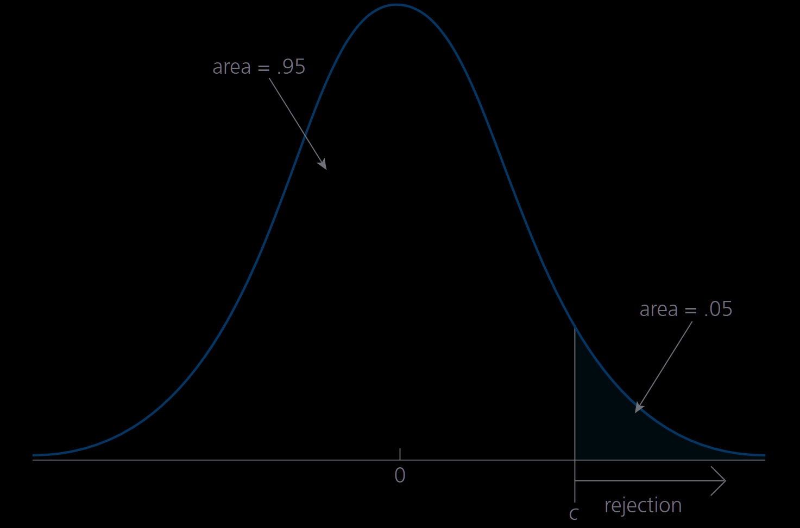
Diseños cuantitativos
1.
Diseño de encuestas
La muestra y la población
Determinación del tamaño de muestra
Definición de la región de rechazo
Con un nivel de significancia del 5%, el valor critico c se escoge de tal manera de que la probabilidad del error de tipo I sea 5%.
Considerando esta especificación de H1, deberíamos rechazar H0 a favor de H1 cuando el valor de la media muestral es suficientemente mayor que mu0.
Con c definido, la región de rechazo es:
Para esto es necesario conocer la probabilidad de rechazar la hipótesis nula cuando es cierta.
Donde c es el percentil 100(1-alpha) en una distribución t con n-1 grados de libertad.
¿Como determinar que el valor de la medición muestral es grande, para rechazar H0 dado el nivel de confianza predeterminado?
Región de rechazo para una prueba de un lado con un nivel de significancia del 5% frente a la alternativa mu>mu0
Bajo la hipótesis nula, la variable aleatoria T de distribuye así:

Slide 63
Diseños cuantitativos
1.
Diseño de encuestas
La muestra y la población
Determinación del tamaño de muestra
¿Qué pruebas estadísticas se deben utilizar?
Hipótesis
Para poder contrastar una hipótesis nula respecto a una especificación alternativa, necesitamos seleccionar una prueba estadística (o estadístico) y un valor crítico
Prueba estadística
T. También definido como estadístico de prueba, es una función de una muestra aleatoria. Cuando se calcula el estadístico para un resultado especifico, este se define como t.
Valor crítico
La elección del estadístico y del valor crítico se basa en la conveniencia y en el deseo de maximizar la potencia (asociada al error tipo II) dado un nivel de significación (asociada al error tipo I) para la prueba.
C. Dado que identificamos un estadístico de prueba, es posible definir las reglas de rechazo que determinan si H0 se rechaza a favor de H1. Todas las reglas de rechazo se basan en la comparación del valor de un estadístico de prueba, t, con un valor crítico, c. Los valores de t que resultan en el rechazo de la hipótesis nula se conocen como la región de rechazo.
a
Definición del nivel de significancia (Alpha)
b
Dado Alpha, el valor critico C se determina a partir de la distribución de T, asumiendo que H0 es verdadera.
La hipótesis acerca de la media de una población que se distribuye de manera normal se presenta de la siguiente manera:
En este caso mu0 es un valor de la media que especificamos bajo la estructura de H0, en muchas aplicaciones ese valor es cero.

Slide 64
Diseños cuantitativos
1.
Diseño de encuestas
La muestra y la población
Determinación del tamaño de muestra
Definición de la región de rechazo
Con un nivel de significancia del 5%, el valor critico c se escoge de tal manera de que la probabilidad del error de tipo I sea 5%.
Considerando esta especificación de H1, deberíamos rechazar H0 a favor de H1 cuando el valor de la media muestral es suficientemente mayor que mu0.
Con c definido, la región de rechazo es:
Para esto es necesario conocer la probabilidad de rechazar la hipótesis nula cuando es cierta.
Donde c es el percentil 100(1-alpha) en una distribución t con n-1 grados de libertad.
¿Como determinar que el valor de la medición muestral es grande, para rechazar H0 dado el nivel de confianza predeterminado?
Región de rechazo para una prueba de un lado con un nivel de significancia del 5% frente a la alternativa mu>mu0
Bajo la hipótesis nula, la variable aleatoria T de distribuye así:

Slide 65
Pruebas de hipótesis acerca de la media en una población normal
🧪 Hipótesis
Para poder contrastar una hipótesis nula respecto a una especificación alternativa, necesitamos seleccionar una prueba estadística (o estadístico) y un valor crítico
1
Prueba estadística
La elección del estadístico y del valor crítico se basa en la conveniencia y en el deseo de maximizar la potencia (asociada al error tipo II) dado un nivel de significación (asociada al error tipo I) para la prueba.
2
Valor crítico

Slide 66
Pruebas de hipótesis acerca de la media en una población normal
1
Prueba estadística
T. También definido como estadístico de prueba, es una función de una muestra aleatoria. Cuando se calcula el estadístico para un resultado especifico, este se define como t.
2
Valor crítico
C. Dado que identificamos un estadístico de prueba, es posible definir las reglas de rechazo que determinan si H0 se rechaza a favor de H1. Todas las reglas de rechazo se basan en la comparación del valor de un estadístico de prueba, t, con un valor crítico, c.
Los valores de t que resultan en el rechazo de la hipótesis nula se conocen como la región de rechazo.

Slide 67
Pruebas de hipótesis acerca de la media en una población normal
Pasos para la definición del valor crítico
a
Definición del nivel de significancia (Alpha)
b
Dado Alpha, el valor critico C se determina a partir de la distribución de T, asumiendo que H0 es verdadera.
🧪 Hipótesis
La hipótesis acerca de la media de una población que se distribuye de manera normal se presenta de la siguiente manera:
En este caso mu0 es un valor de la media que especificamos bajo la estructura de H0, en muchas aplicaciones ese valor es cero

Slide 68
Pruebas de hipótesis acerca de la media en una población normal
Definición de la región de rechazo
Alternativas de un lado
La región de rechazo que se escoja depende de la naturaleza de la hipótesis alternativa. Para el caso de hipótesis simples respecto a la media contamos con las siguientes posibilidades
Apropiadas cuando estamos interesados en valor del parámetro cuando este es al menos tan grande como el valor de comparación (mu0)
Alternativas de dos lados
Apropiadas cuando estamos interesados en cualquier tipo de diferencia respecto al valor establecido en la hipótesis nula

Slide 69
Pruebas de hipótesis acerca de la media en una población normal
Definición de la región de rechazo
¿Como determinar que el valor de la medición muestral es grande, para rechazar H0 dado el nivel de confianza predeterminado?
Considerando esta especificación de H1, deberíamos rechazar H0 a favor de H1 cuando el valor de la media muestral es suficientemente mayor que mu0.
🧪
Para esto es necesario conocer la probabilidad de rechazar la hipótesis nula cuando es cierta.
Bajo la hipótesis nula, la variable aleatoria T de distribuye así:

Slide 70
Pruebas de hipótesis acerca de la media en una población normal
Definición de la región de rechazo
Región de rechazo para una prueba de un lado con un nivel de significancia del 5% frente a la alternativa mu>mu0
Con un nivel de significancia del 5%, el valor critico c se escoge de tal manera de que la probabilidad del error de tipo I sea 5%.
Con c definido, la región de rechazo es:
Donde c es el percentil 100(1-alpha) en una distribución t con n-1 grados de libertad.

Slide 71
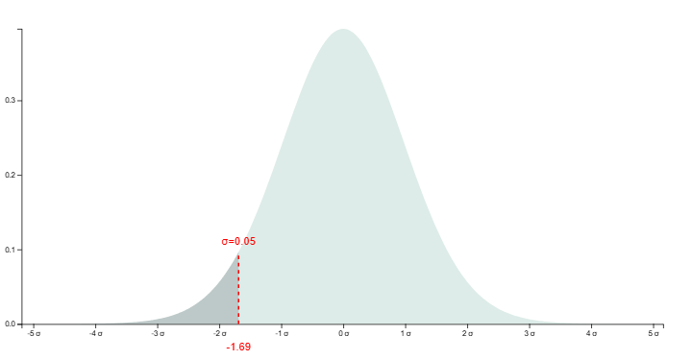
Pruebas de hipótesis acerca de la media en una población normal
Definición de la región de rechazo
Región de rechazo para una prueba de un lado con un nivel de significancia del 5% frente a la alternativa mu<mu0
Con un nivel de significancia del 5%, el valor critico c se escoge de tal manera de que la probabilidad del error de tipo I sea 5%.
Con c definido, la región de rechazo es:

Slide 72
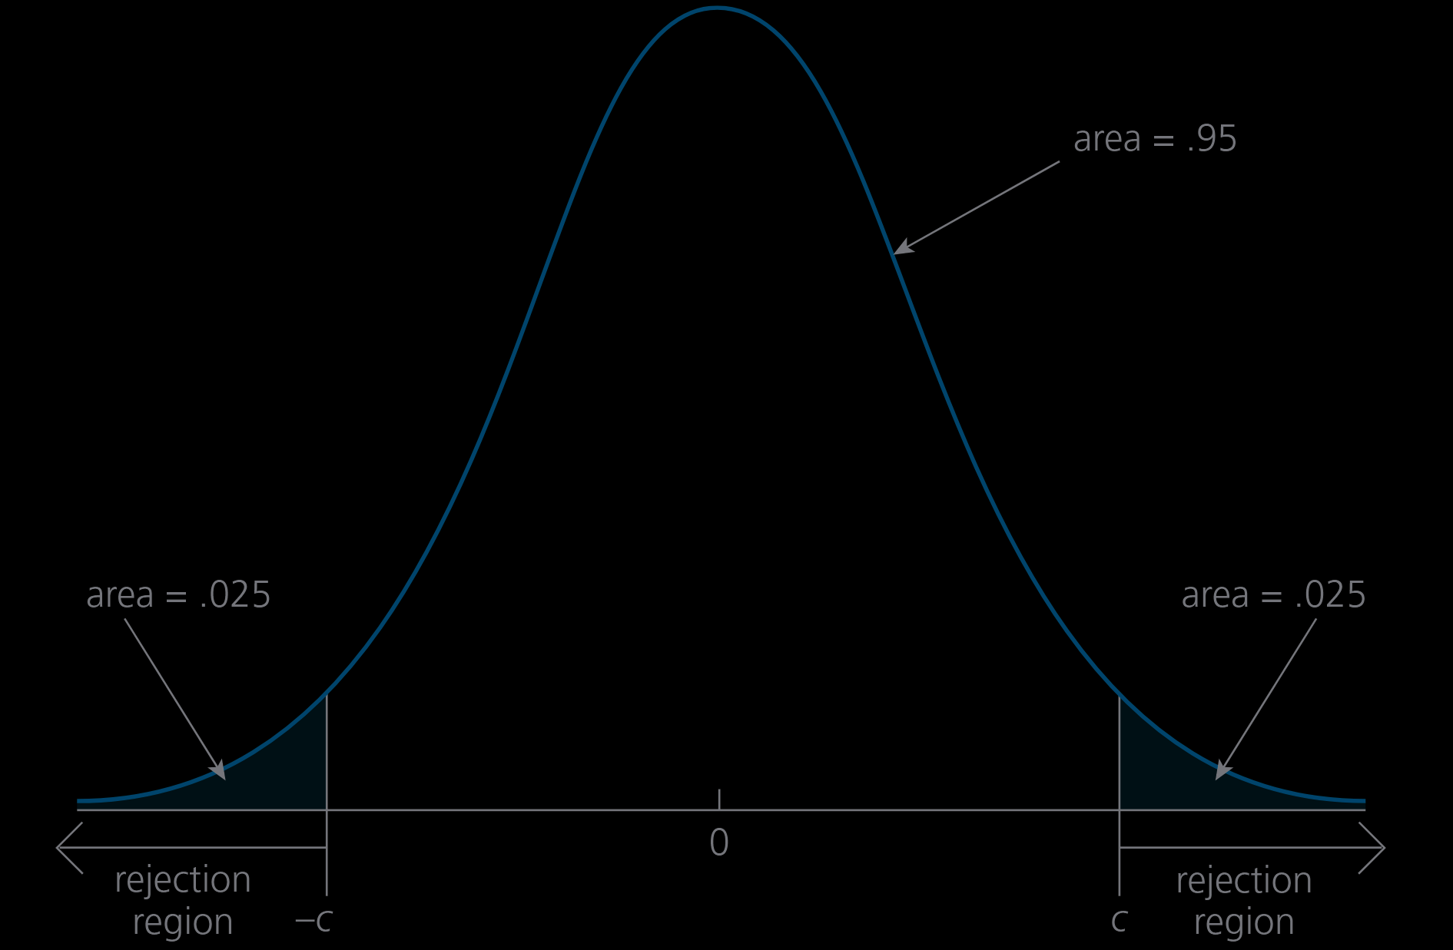
Pruebas de hipótesis acerca de la media en una población normal
Definición de la región de rechazo
Región de rechazo para una prueba de un lado con un nivel de significancia del 5% frente a la alternativa mu diferente de mu0
En el caso de alternativas de dos lados es importante seleccionar un valor critico que permita que el nivel de significancia de la prueba siga siendo ɑ.
Con c definido, la región de rechazo es:
En este caso c es el percentil 100(1- ɑ/2) de la distribución t con n-1 grados de libertad

Slide 73
Cálculo y uso de valores P
¿Cuál es el mayor nivel de significación al que podríamos realizar la prueba y aun así no rechazar la hipótesis nula? Este valor se conoce como valor p de una prueba
Con el valor t establecido, podemos encontrar el mayor nivel de significancia al que no podríamos rechazar H0. Este es el nivel de asociado al uso de t como valor crítico. Dado que nuestro estadístico de prueba T tiene una distribución normal estándar bajo H0, tenemos
En comparación con la elección anticipada de un nivel de significancia y la obtención de un valor crítico, el cálculo de un valor p es algo más difícil.
Donde Phi denota la función de densidad normal estándar.
En otras palabras, el valor p en este ejemplo es el área a la derecha de 1.52, el valor observado del estadístico de prueba, en una distribución normal estándar

Slide 74
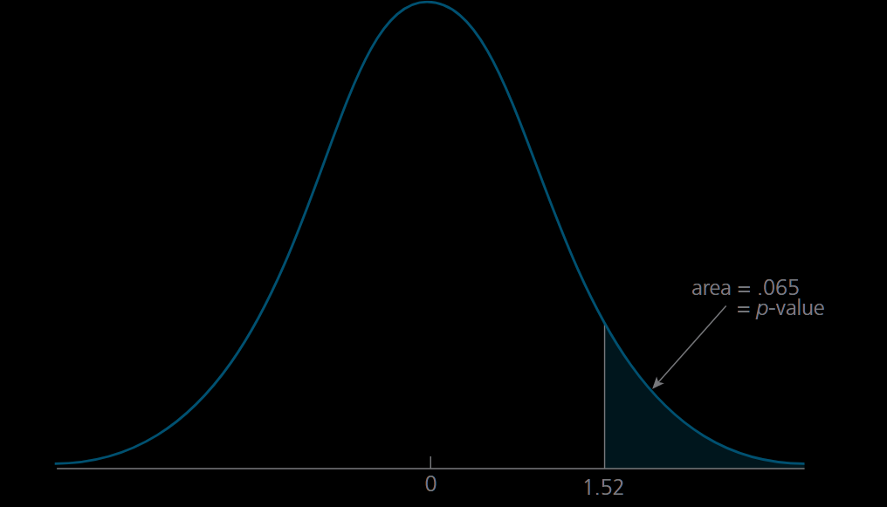
Cálculo y uso de valores P
En otras palabras, el valor p en este ejemplo es el área a la derecha de 1.52, el valor observado del estadístico de prueba, en una distribución normal estándar.
Dado que el valor p es 0.065, el mayor nivel de significancia al que podemos realizar esta prueba y no rechazarla es el 6,5%.
Si realizamos la prueba a un nivel inferior al 6,5% (por ejemplo, al 5%), no rechazaremos H0.
Si realizamos la prueba a un nivel superior al 6,5% (por ejemplo, al 10%), rechazamos H0.
El valor p en este ejemplo tiene otra interpretación útil: es la probabilidad de que observemos un valor de T tan grande como 1.52 cuando la hipótesis nula es cierta.
Si la hipótesis nula es realmente cierta, observaríamos un valor de T tan grande como 1.52 debido al azar sólo el 6.5% de las veces. Que esto sea lo suficientemente pequeño como para rechazar H0 depende de nuestra tolerancia a un error de tipo I.

Slide 75
Cálculo y uso de valores P
En otras palabras, el valor p en este ejemplo es el área a la derecha de 1.52, el valor observado del estadístico de prueba, en una distribución normal estándar.
Generalmente, los valores p pequeños son una prueba contra H0, ya que indican que el resultado de los datos se produce con poca probabilidad si H0 es cierta.
En el ejemplo anterior, si t hubiera sido un valor mayor, digamos, t = 2.85, entonces el valor p sería 0.002.
Esto significa que, si la hipótesis nula fuera cierta, observaríamos un valor de T tan grande como 2.85 con probabilidad .002.
O bien hemos obtenido una muestra muy poco habitual
O la hipótesis nula es falsa.
A menos que tengamos una tolerancia muy pequeña al error de tipo I, rechazaríamos la hipótesis nula.

Slide 76
Cálculo y uso de valores P
1
Elija un estadístico de prueba T y decida la naturaleza de la hipótesis alternativa.
Esto determina si la regla de rechazo es
t > c
t<-c
|t| > c
El cálculo de un valor p para una prueba bilateral es similar, pero debemos tener en cuenta la naturaleza de dos colas de la regla de rechazo. Para las pruebas t sobre medias poblacionales, el valor p se calcula como
2
Utilice el valor observado de la estadística t como valor crítico y calcule el correspondiente nivel de significación de la prueba. Éste es el valor p. Si la regla de rechazo es de la forma:
t > c, entonces p-valor = P(T>t)
t < -c, entonces p-valor = P(T<t)
|t| > c, entonces p-valor = P(|T|>|t|)
Donde t es el valor del estadístico de prueba y T es una variable aleatoria t. (Para n grande, sustituya T por una variable aleatoria normal estándar.)
Así, calcule el valor absoluto del estadístico t, encuentre el área a la derecha de este valor en una distribución t y multiplique el área por dos.
3
Si se ha elegido un nivel de significancia , entonces no rechazamos H0 a ese nivel si p-valor > ɑ . Si p-valor < ɑ , entonces rechazamos H0 al nivel 100 ɑ %.

Slide 77
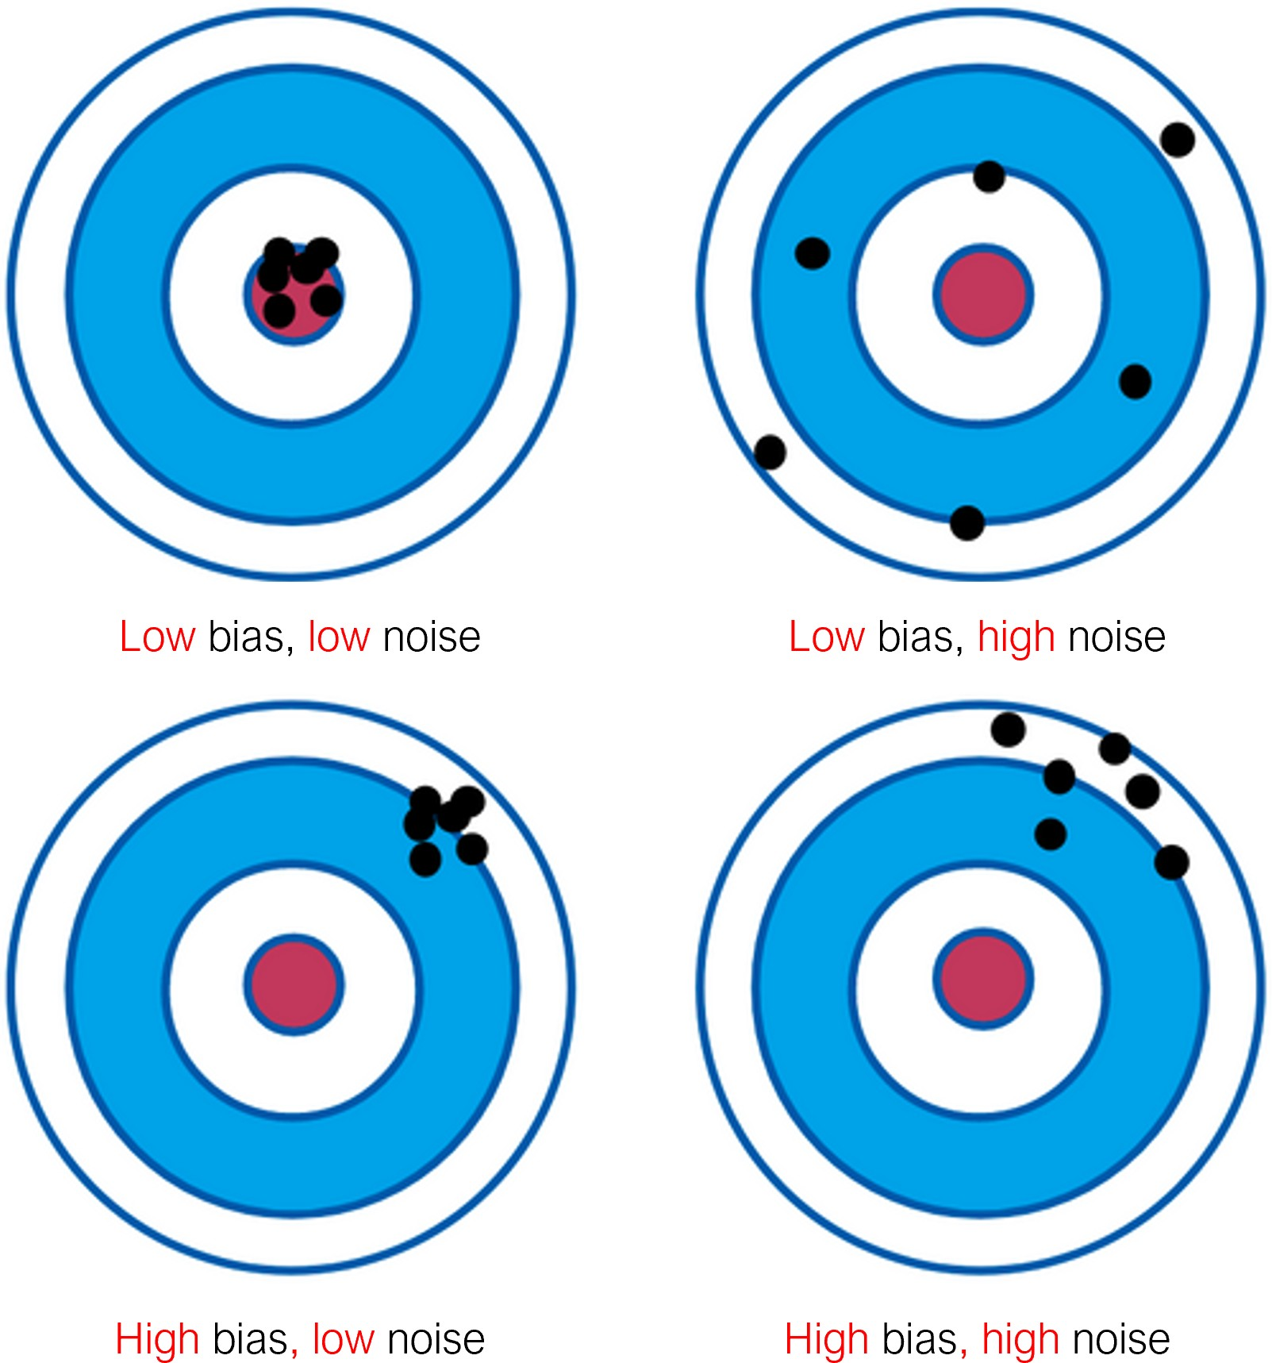
Diseños cuantitativos
1.
Diseño de encuestas
Si se quiere estimar el valor medio de una variable relevante en una población, se pueden aplicar métodos de muestreo.
Debido a la naturaleza estocástica del proceso de selección de la muestra, algunas observaciones estarán por encima o por debajo del promedio general.
Por lo tanto, no todas las estimaciones de la muestra serán exactamente iguales al promedio verdadero de la población.
Estas diferencias con respecto a la media de la población son los errores.
Con suficientes observaciones de la muestra, este error tiende a cero, esperamos que los errores sean aleatorios, no sistemáticos.
Kahneman, D., Sibony, O., & Sunstein, C. R. - Noise: A flaw in human judgment

